Slide 1
Database Design Fundamentals
Solving Problems Before they Start!
Edward Pollack
Microsoft Data Platform MVP

Slide 2
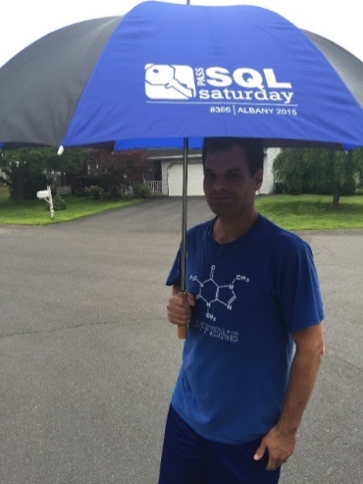






Ed Pollack
Microsoft Data Platform MVP
Published author of:
Dynamic SQL: Applications, Performance, and Security, 2nd Edition
Analytics Optimization with Columnstore Indexes in SQL Server
Published in Expert T-SQL Functions in SQL Server, 3rd Edition
Expert Performance Indexing in SQL Server, 4th Edition
Author on Simple Talk.
Organizes:
SQL Saturday New York City
SQL Saturday Albany 2024
Future Data Driven
Capital Area SQL Server User Group
Speaker at many data events
Find me on: LinkedIn

Slide 3














Slide 4
Agenda
Why does database design matter?
What is needed to make good decisions?
Examples of database design best practices.
Decisions & considerations when creating data structures.
Conclusion & questions (?)
BONUS: Think about your best data-related stories. The bloopers. The mishaps. The oopses. The clicks that maybe should not have been clicked. The code that should never have been committed.
This is a Timeless Topic!!!

Slide 5
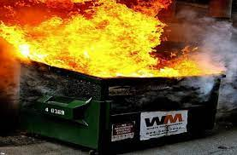
Why Database Design Matters
Align business needs with implementation
Better performance
Scalability
Ease of documentation
Decrease maintenance costs (aka: technical debt)
Less bugs
Avoid this:

Slide 6
Business/Application Logic
What is the business/organization need?
This is often non-technical!
What will the database/data be used for?
How is it accessed? Who uses it?
What kind of data is it?
What is the future of this data?
Data structures cannot be effectively built without understanding their purpose

Slide 7
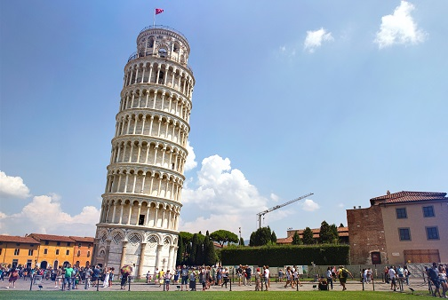
Where Do I Put My data?
Choose ideal data structures for different types of data. For example:
Transactional/ACID data: SQL Server, or a relational/transactional database.
Transactional/non-ACID data: Cosmos DB, or a NoSQL solution.
Structured analytic data: Data warehouse: Synapse, Fabric, Columnstore, etc…
Unstructured analytic data: Data lake, parquet, Fabric, etc…
Files/Images: File system, file store. NOT an OLTP database!
Documents: Document store (file system, NoSQL, etc…). NOT an OLTP database!
Text searching/parsing: Elastic Search, Azure Cognitive Search (optimized for text).
3rd party services.
On-premises vs. cloud.
Which cloud?
Beware vendor lock-in!
Easy decision to make. Hard to unmake!
Beware app bias!

Slide 8

Scalability
Design for today, tomorrow, and the future…YEARS from now!
Hardware
Software
Licensing
Data size and change over time (row/object count, space used)
Contention & Concurrency
High Availability & Disaster Recovery. Define your RTO and RPO!
Re-evaluate scalability periodically as an app grows/evolved over time.

Slide 9
Designing Data Structures
One table = one distinct entity
One column = one distinct data element
Choose a single table type per object:
Entity
Lookup
Relationship
All OLTP tables should have a clustered index. Exceptions to that are rare.
For OLTP: unique/increasing/narrow.
For OLAP: Clustered columnstore.
Clustered indexes will typically align with primary key (or maybe a critical alternate key). If not, ask why.
Constraints: Do uniqueness, defaults, check constraints, or foreign keys matter?
Indexing: What are common search/join/aggregation scenarios?

Slide 10
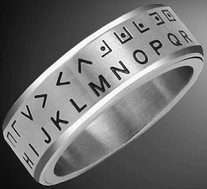
Data Types
Choose a natural data type
Choose the ideal data length, precision, and size.
Unsure what to do? Use a standard!
ISO5218 for gender, ISO4217 for currency, ISO3166 for country, etc…
Bit = 0 or 1. Not TINYINT, SMALLINT, INT, VARCHAR(1). Avoid NULL!
Decimals & Numeric? Consider what mathematical operations will be performed on that data. Money - think carefully! Consider rounding.
Do not encode data into unnatural data types!
Sure, bitmaps are cool, but are hard to read/understand without a secret decoder ring.
People often look at column definitions to understand data!

Slide 11

Dates & Times
Be consistent across all tables!
Will time zones matter? If so, use DATETIMEOFFSET or similar.
Use UTC or a non-daylight savings standard! PLEASE!!!
Store in correctly-sized/scoped data type:
Times = TIME
Dates = DATE
Datetimes = DATETIME2, DATETIMEOFFSET, etc…
Avoid strings, integers, or decimals for dates/times.
Differentiate between dates/times and duration
Duration has units like SECOND, MILLISECOND, or MINUTE.
Configure database/app/web servers in UTC w/ no daylight savings.

Slide 12

NULL
NULL = Does Not Exist. It is NOT A VALUE!
Do not make up “De-nullifiers” unless they have true meaning!
‘’, -1, ‘1/1/1900’, ‘N/A’, ‘00:00:00’…
NOT NULL means:
Required by the application
Always has a meaningful value
NULL
Decide what it means
SET ANSI NULLS ON/OFF (beware NULL behavior)
Normalization can remove NULL if problematic
Consider how an application handles NULL, if needed

Slide 13
Naming Objects
What is it? Do not name for location, time, usage, new-ness, etc…
Column names should be unique and used consistently across all entities.
BIT columns should describe what is being tested, such as:
Is_Deleted, is_administrator, IsActive, has_seventeen_pizzas, etc…
Avoid abbreviations/shorthand. Do not fear longer object names!
AccountOwner is better than ActOwr. BusinessRepresentive is better than Brep.
Avoid spaces, special characters, etc…They break things!
Avoid reserved words. They are confusing and break things!
Object names should be as self-explanatory as possible.

Slide 14
OLAP vs. OLTP
Transactional data is VERY different from analytic data!
OLTP: Fewer rows, more columns, more updates/inserts/deletes/single-row operations.
OLAP: More rows, fewer columns, mostly inserts, more aggregation and operations across many rows.
Separate reporting/analytics from transactional processing as much as possible.
Different tools may be needed for each.
Mixing OLAP/OLTP will get expensive and perform poorly as data size and contention increase.

Slide 15
Data Quality & Data Integrity
Data lives and dies by its quality.
Use:
Foreign keys
Check constraints
Default constraints
Validation processes
Bad data in = bad data out
Analytics?
Business Intelligence?
Dashboarding?
Machine learning?
AI?
Data integrity often improves performance, as well!

Slide 16
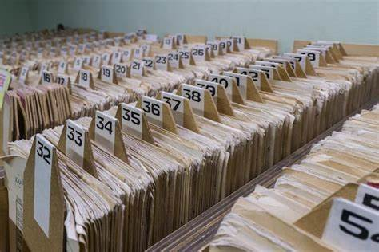
Old Data
Is data needed forever?
Can old data be:
Deleted/Inactivated/Partitioned/Archived?
Compressed?
Is archiving allowed, desired, or required?
How is data associated with archived data handled?
Have a data retention policy!
Compliance needs
Contractual obligations
Keeps data size manageable
Saves $$$
Improves performance
When building new data structures, ask what its retention will be!
Can old data be stored elsewhere? Is keeping it for posterity good enough?

Slide 17
Internationalization/Localization
Will customers ever reside in other countries?
If so, consider:
Date/time/number/string formats
Size/format of addresses, phone numbers, etc…
Time zones
Language (Applies within a home country, too!)
Metadata for locality/users/data
Easier to incorporate now, rather than later.

Slide 18

Conclusion
Good database design saves time, effort, and money!
Creates data structures that are easier to understand and use.
Poor design = Technical debt!
Simple is better, when possible.
Future you will thank current you for making more thoughtful decisions now.

Slide 19


Session Evaluation Win 6x$50 gift card
Event Evaluation Win $100 gift card

Slide 20
Thank You!
Find me here:
ed@edwardpollack.com
Ed Pollack | LinkedIn
Find my content here:
EdwardPollack (Ed Pollack) (github.com)
Edward Pollack, Author at Simple Talk (red-gate.com)
Ed Pollack, Author at SQL Shack - articles about database auditing, server performance, data recovery, and more

